Slide 1
Improving Fetal Health Outcomes:
Data Cleaning Process and Exploratory Data Analysis
A closer look into the technical process..

Slide 2
Fetal Health Data Set
“Reduction of child mortality is reflected in several of the United Nations' Sustainable Development Goals and is a key indicator of human progress.
The UN expects that by 2030, countries end preventable deaths of newborns and children under 5 years of age, with all countries aiming to reduce under 5 mortality to at least as low as 25 per 1,000 live births.
Parallel to notion of child mortality is of course maternal mortality, which accounts for 295,000 deaths during and following pregnancy and childbirth (as of 2017). The vast majority of these deaths (94%) occurred in low-resource settings, and most could have been prevented.
In light of what was mentioned above, Cardiotocograms (CTGs) are a simple and cost accessible option to assess fetal health, allowing healthcare professionals to take action in order to prevent child and maternal mortality. The equipment itself works by sending ultrasound pulses and reading its response, thus shedding light on fetal heart rate (FHR), fetal movements, uterine contractions and more.”
Ayres de Campos et al. (2000) SisPorto 2.0 A Program for Automated Analysis of Cardiotocograms. J Matern Fetal Med 5:311-318
Notes:
Objective
To describe the latest version of SisPorto, a program for automated analysis of cardiotocograms that closely follows the FIGO guidelines, analyses ante- and intrapartum tracings, performs no signal reduction, and has the possibility of simultaneously recording twins.
Methods
A detailed description of the program's processing algorithms and operation is provided, as well as the main results of the studies performed to-date with this system.

Slide 3

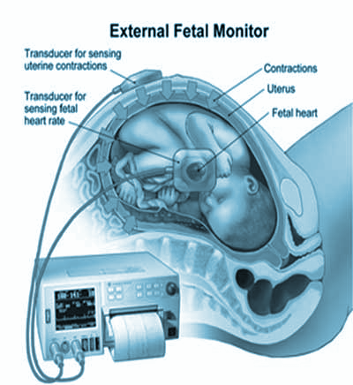
Cardiotocogram
(CTGs)

Slide 4
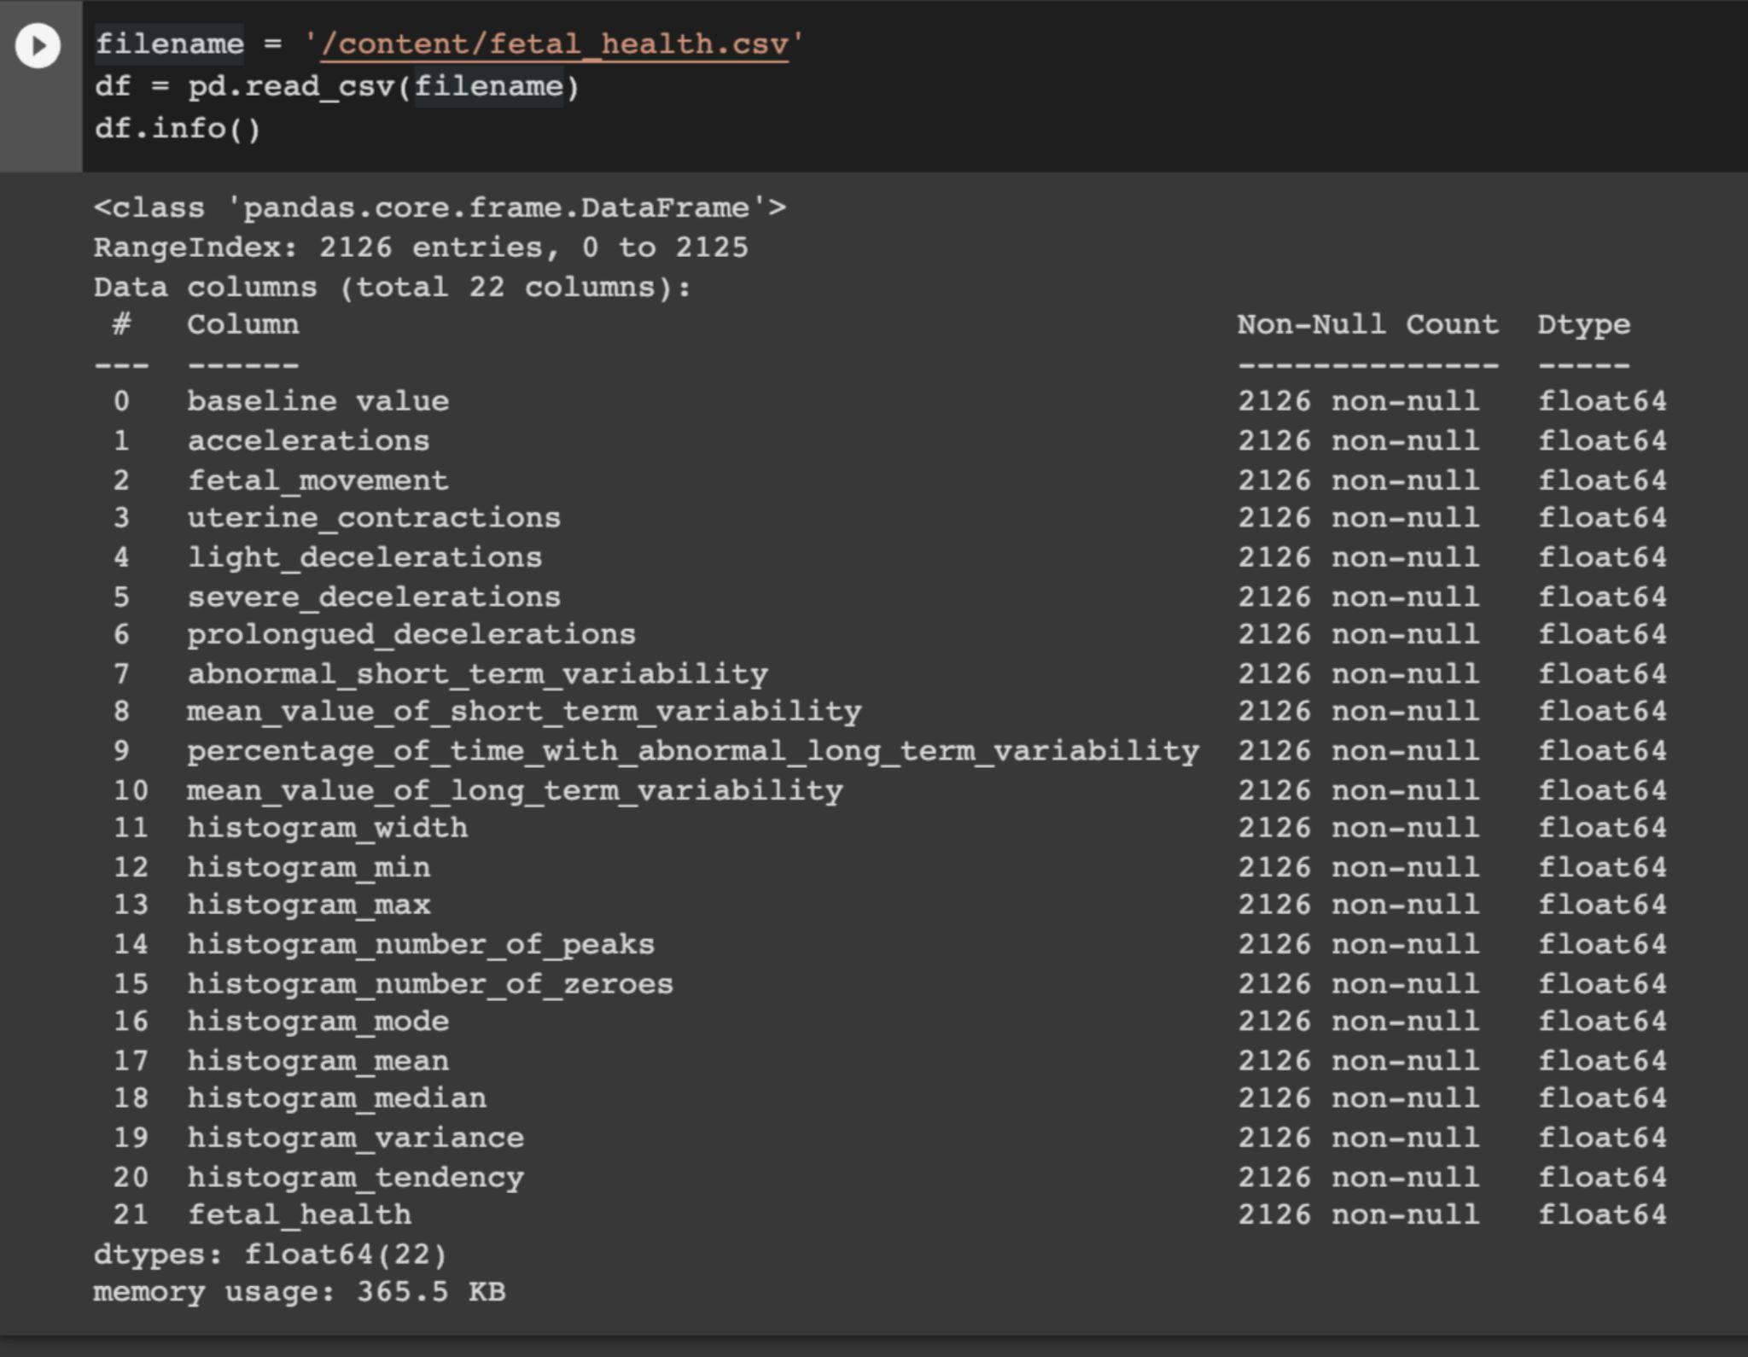
Fetal Health Dataset
Notes:
Baseline Fetal Heart Rate (FHR)
Number of accelerations per second
Number of fetal movements per second Number of uterine contractions per second
Number of LDs per second
Number of SDs per second
Number of PDs per second
Percentage of time with abnormal short term variability
Mean value of short term variability
Percentage of time with abnormal long term variability
Fetal Health - 1normal, 2suspect, 3pathological

Slide 5
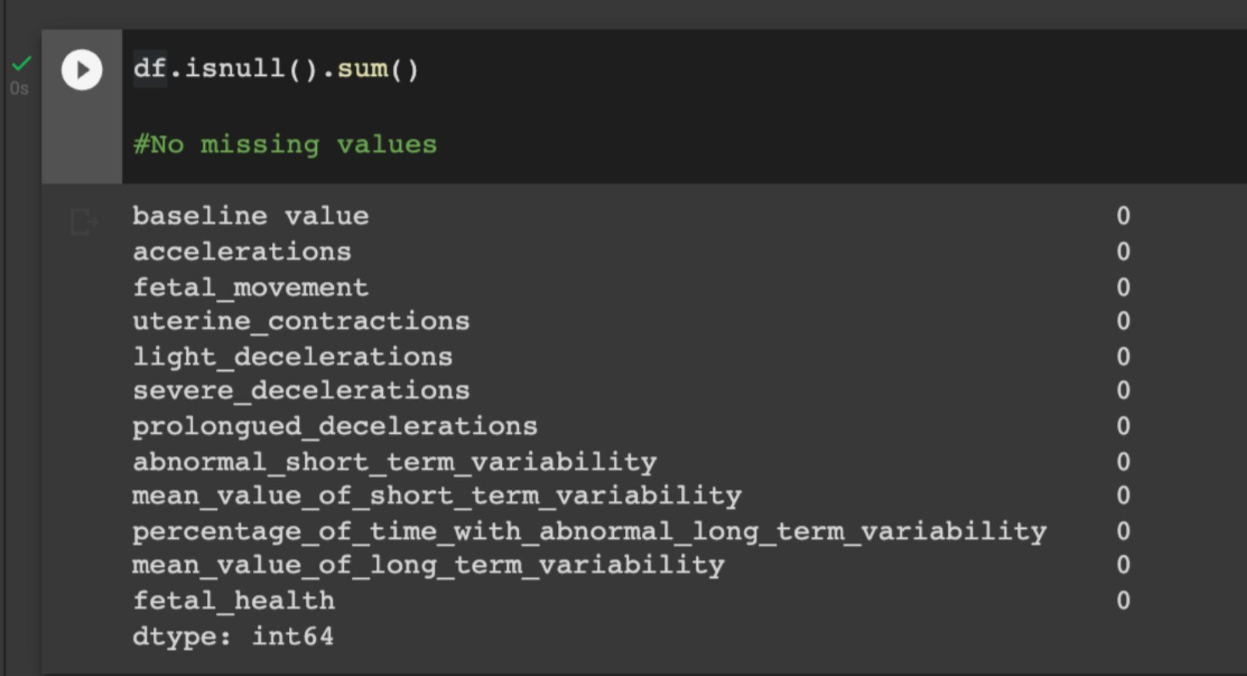
Data Cleaning
Notes:
Baseline Fetal Heart Rate (FHR)
Number of accelerations per second
Number of fetal movements per second Number of uterine contractions per second
Number of LDs per second
Number of SDs per second
Number of PDs per second
Percentage of time with abnormal short term variability
Mean value of short term variability
Percentage of time with abnormal long term variability
Fetal Health - 1normal, 2suspect, 3pathological

Slide 6
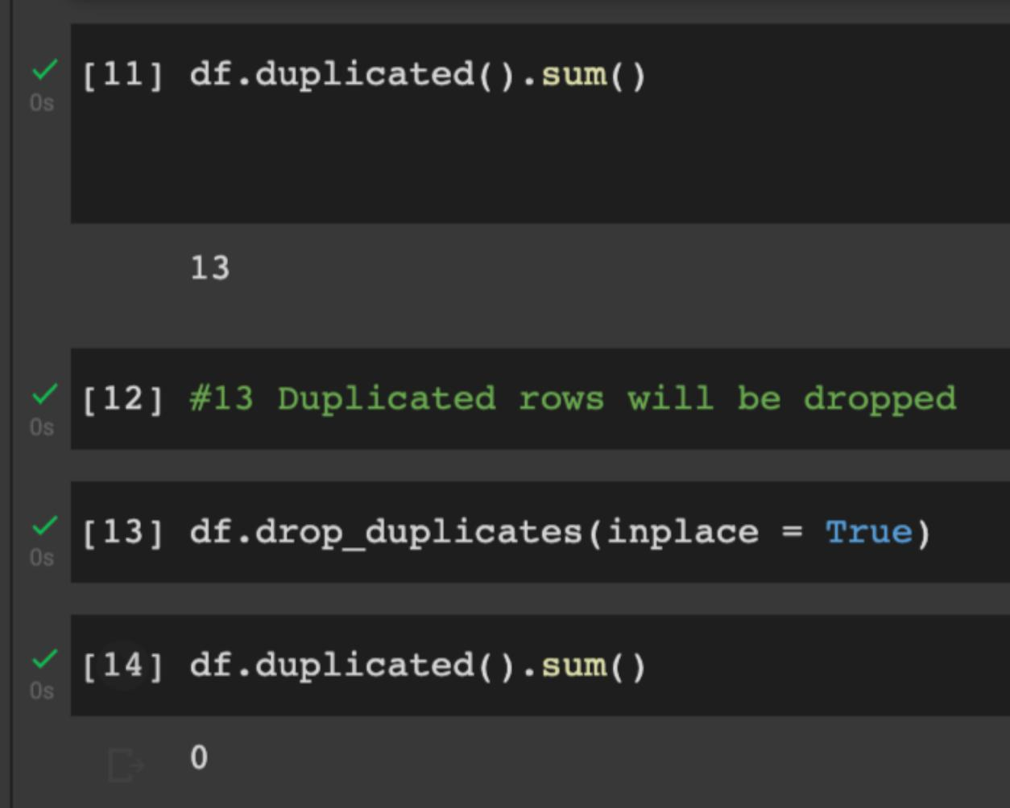
Resolving duplicated rows
Notes:
Baseline Fetal Heart Rate (FHR)
Number of accelerations per second
Number of fetal movements per second Number of uterine contractions per second
Number of LDs per second
Number of SDs per second
Number of PDs per second
Percentage of time with abnormal short term variability
Mean value of short term variability
Percentage of time with abnormal long term variability
Fetal Health - 1normal, 2suspect, 3pathological

Slide 7
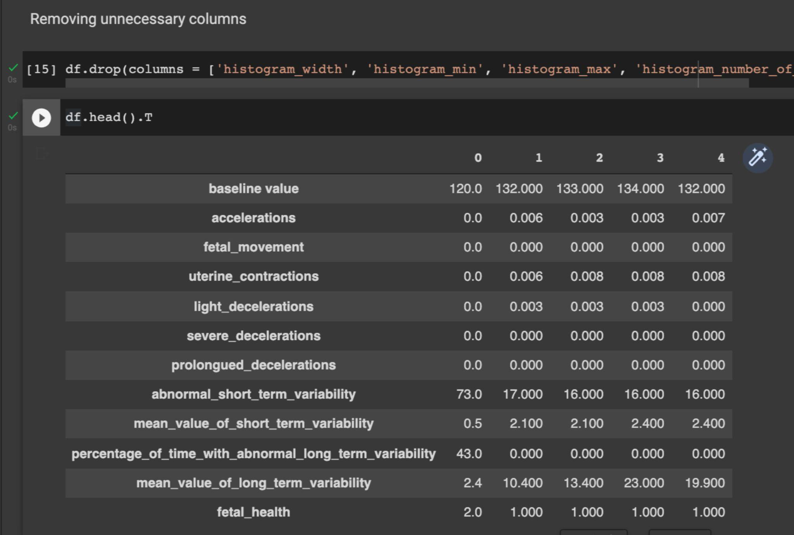
Eliminating unnecessary columns
Notes:
Baseline Fetal Heart Rate (FHR)
Number of accelerations per second
Number of fetal movements per second Number of uterine contractions per second
Number of LDs per second
Number of SDs per second
Number of PDs per second
Percentage of time with abnormal short term variability
Mean value of short term variability
Percentage of time with abnormal long term variability
Fetal Health - 1normal, 2suspect, 3pathological

Slide 8
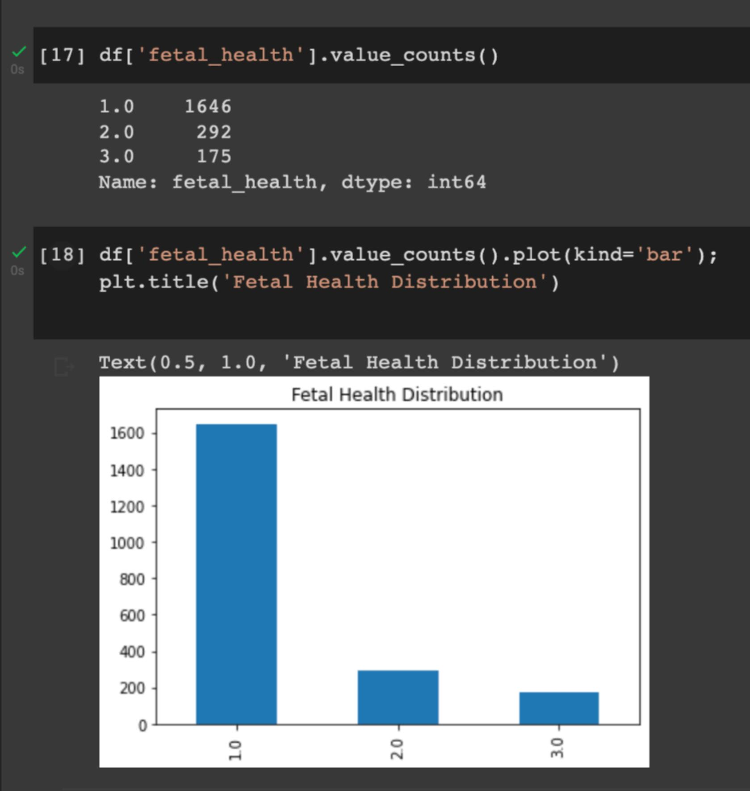
Visualizing
Fetal Health Distribution
in this dataset:
Notes:
Baseline Fetal Heart Rate (FHR)
Number of accelerations per second
Number of fetal movements per second Number of uterine contractions per second
Number of LDs per second
Number of SDs per second
Number of PDs per second
Percentage of time with abnormal short term variability
Mean value of short term variability
Percentage of time with abnormal long term variability
Fetal Health - 1normal, 2suspect, 3pathological

Slide 9
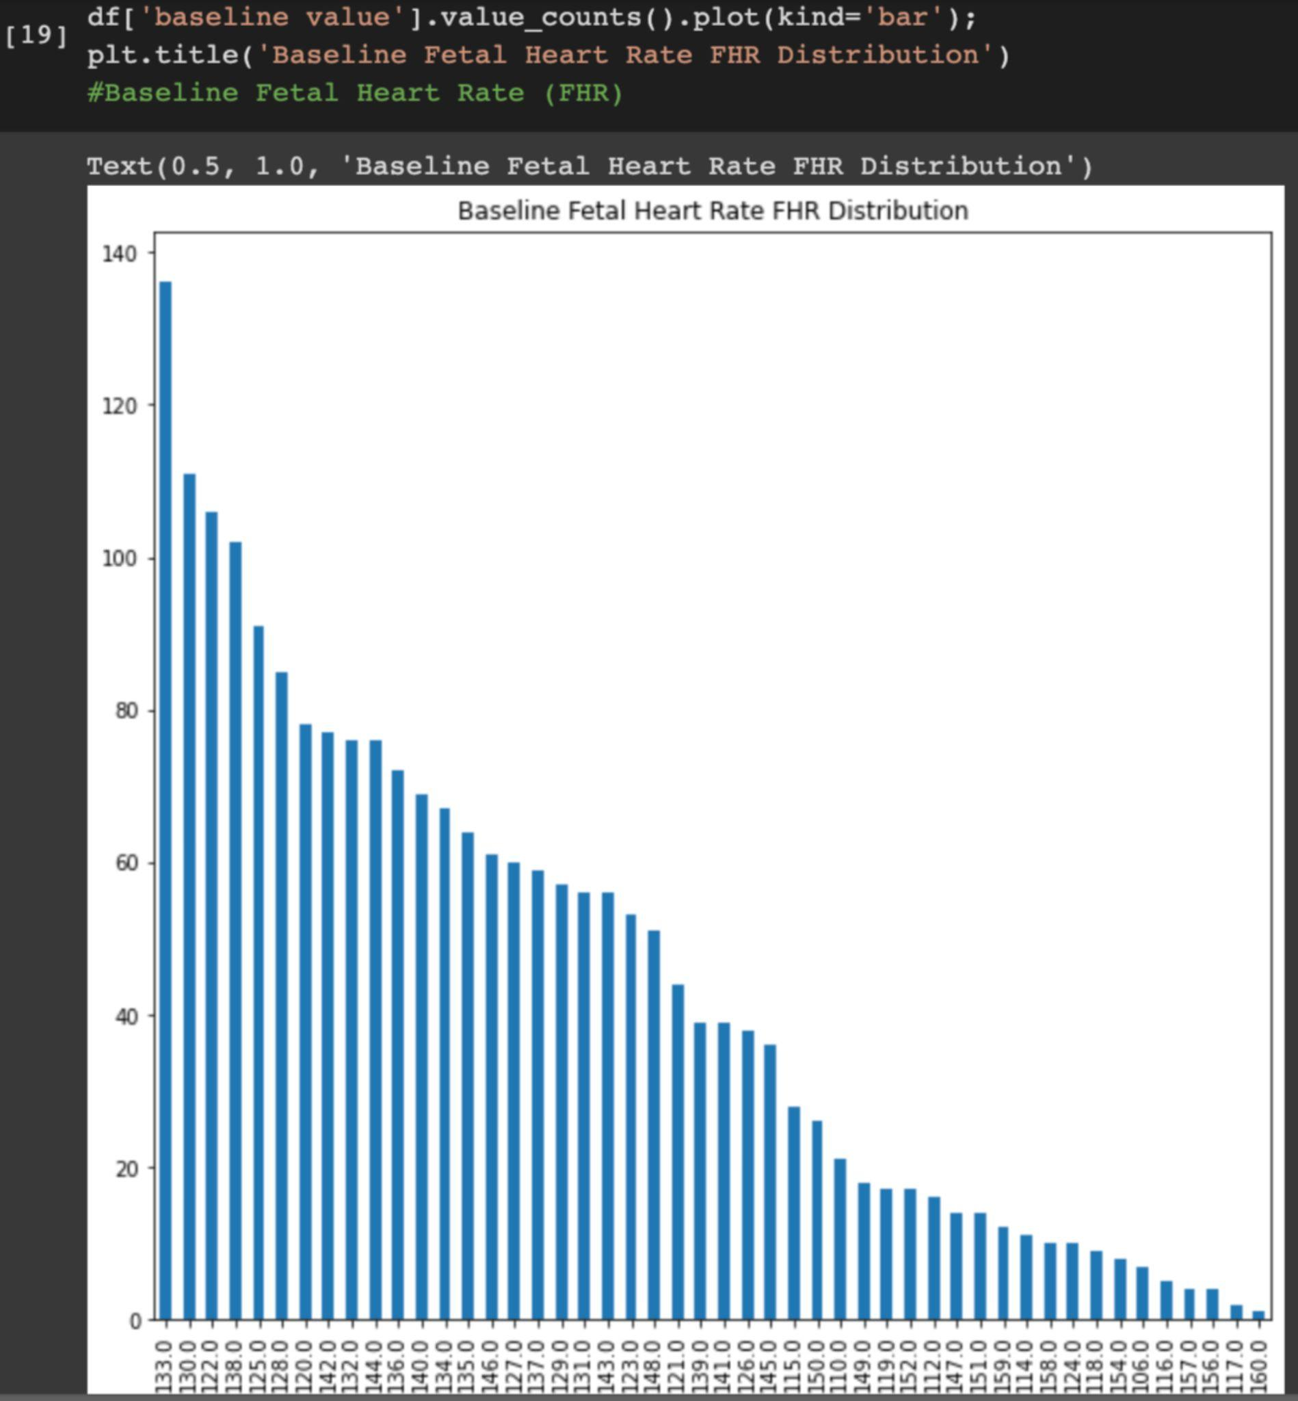
Visualizing the Baseline Fetal Heart Rate bpm Distribution:
Notes:
Baseline Fetal Heart Rate (FHR)
Number of accelerations per second
Number of fetal movements per second Number of uterine contractions per second
Number of LDs per second
Number of SDs per second
Number of PDs per second
Percentage of time with abnormal short term variability
Mean value of short term variability
Percentage of time with abnormal long term variability
Fetal Health - 1normal, 2suspect, 3pathological

Slide 10
Visualizing the Baseline Fetal Heart Rate bpm Distribution:
Notes:
Baseline Fetal Heart Rate (FHR)
Number of accelerations per second
Number of fetal movements per second Number of uterine contractions per second
Number of LDs per second
Number of SDs per second
Number of PDs per second
Percentage of time with abnormal short term variability
Mean value of short term variability
Percentage of time with abnormal long term variability
Fetal Health - 1normal, 2suspect, 3pathological

Slide 11
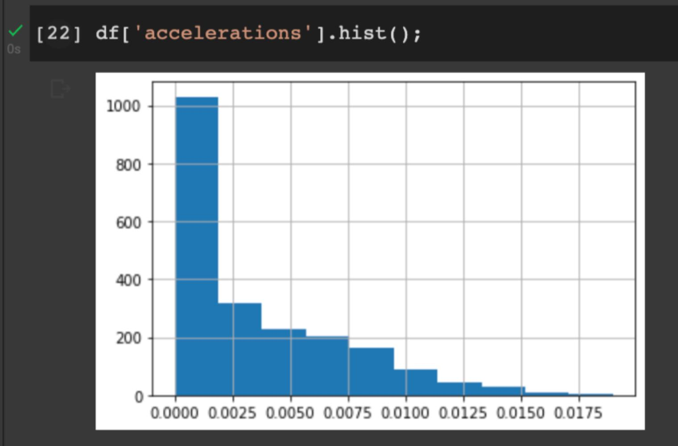
Distribution of FHR accelerations per second:
Notes:
Baseline Fetal Heart Rate (FHR)
Number of accelerations per second
Number of fetal movements per second Number of uterine contractions per second
Number of LDs per second
Number of SDs per second
Number of PDs per second
Percentage of time with abnormal short term variability
Mean value of short term variability
Percentage of time with abnormal long term variability
Fetal Health - 1normal, 2suspect, 3pathological

Slide 12
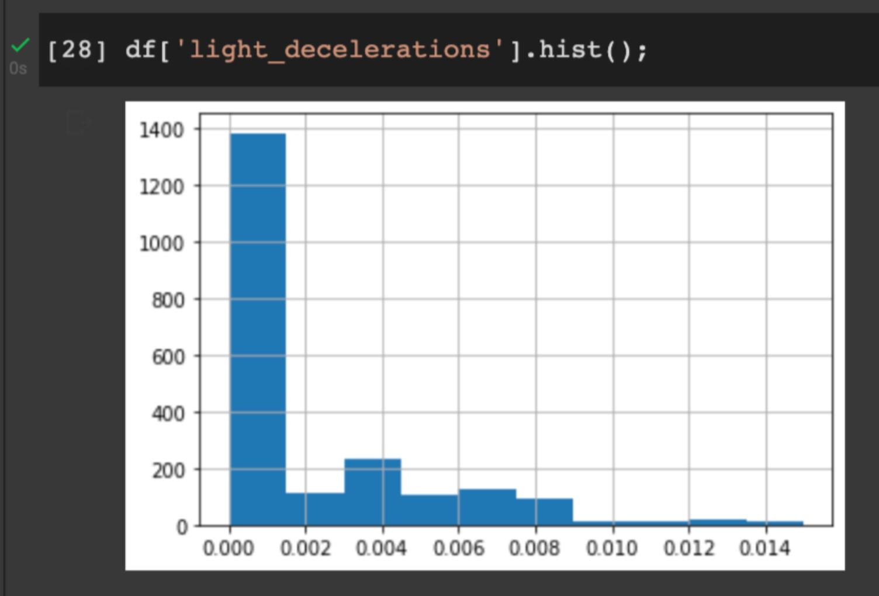
Distribution of FHR decelerations per second:
Notes:
Baseline Fetal Heart Rate (FHR)
Number of accelerations per second
Number of fetal movements per second Number of uterine contractions per second
Number of LDs per second
Number of SDs per second
Number of PDs per second
Percentage of time with abnormal short term variability
Mean value of short term variability
Percentage of time with abnormal long term variability
Fetal Health - 1normal, 2suspect, 3pathological

Slide 13
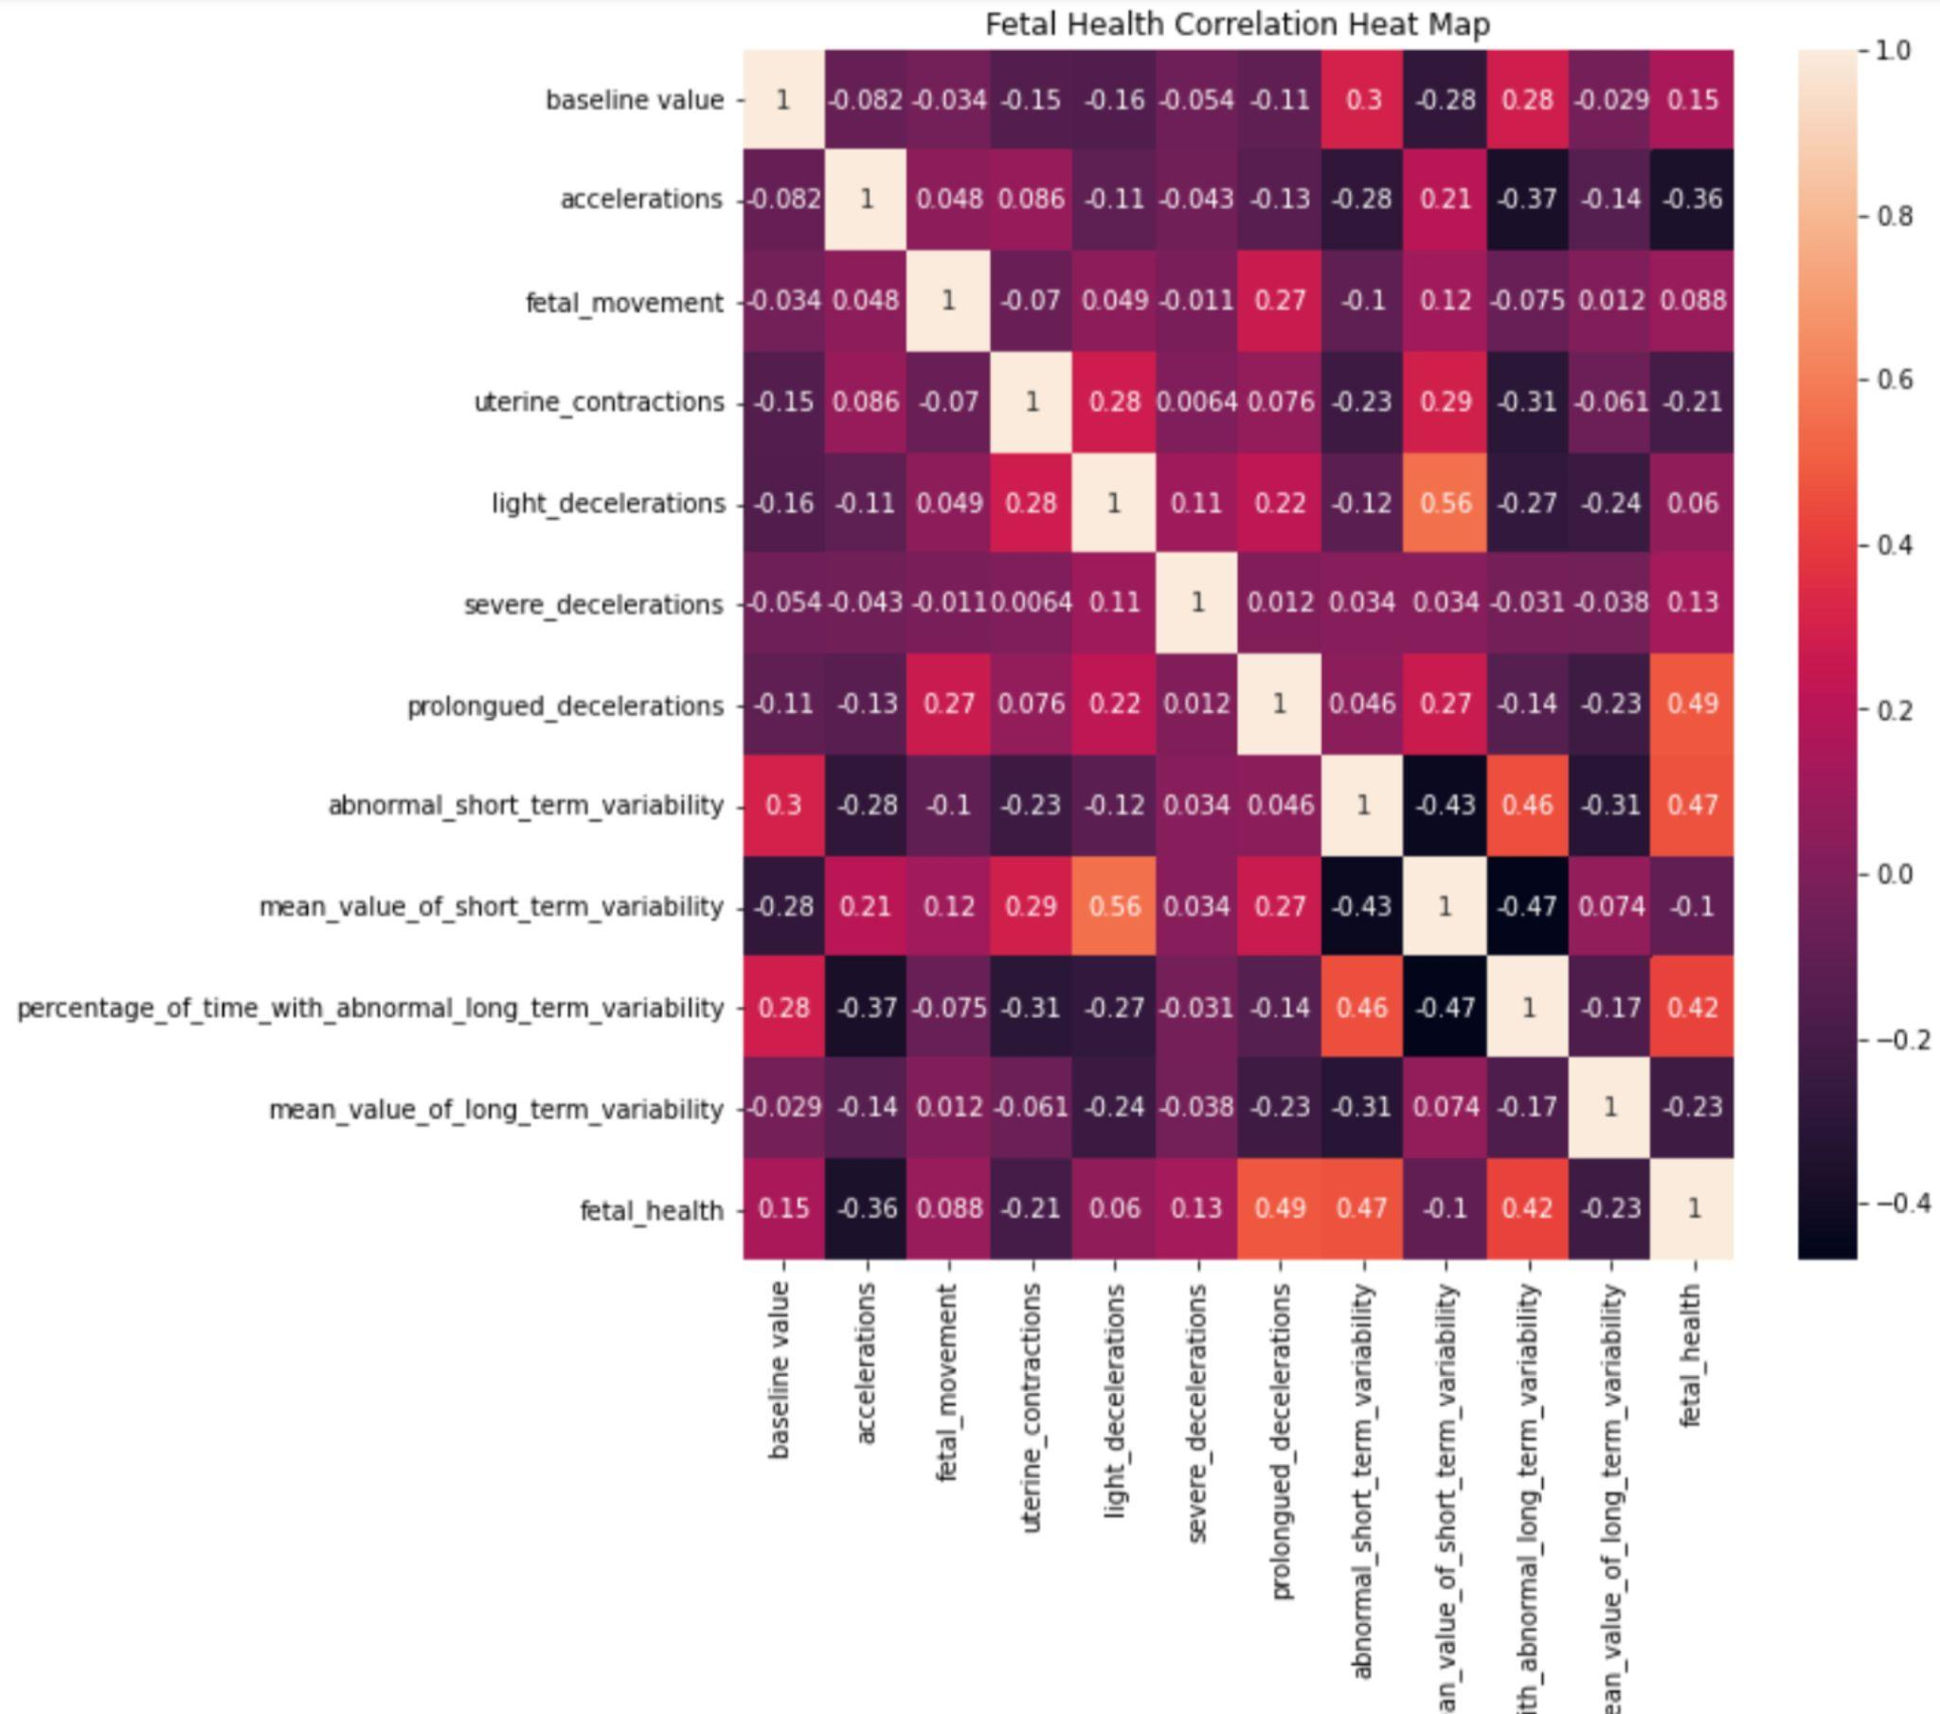
Visualizing correlations of Fetal Health Data and emerging
Fetal Health Predictors
Notes:
Baseline Fetal Heart Rate (FHR)
Number of accelerations per second
Number of fetal movements per second Number of uterine contractions per second
Number of LDs per second
Number of SDs per second
Number of PDs per second
Percentage of time with abnormal short term variability
Mean value of short term variability
Percentage of time with abnormal long term variability
Fetal Health - 1normal, 2suspect, 3pathological

Slide 14
Possible next steps..
01
Supervised Machine Learning
02
Unsupervised Machine Learning
03
Deliver results
Fetal Health as target vector
Cluster Fetal Health Indicators to identify essential health data for outcome prediction
Analyse machine learning models and deliver results to providers

Slide 15
Thank you!
Email questions:
eva.vukich@gmail.com

